Slide 1
C2P India
QA Track
Routing & Hands On

Slide 2
Agenda
Question and Answers
Hands-On
Routing

Slide 3
Agenda
Routing
Question and Answers
Hands-On

Slide 4
Routing
Routing means deciding the path which the payment will take to reach the destination account (Credit Party Account)
The system will try and find out the cheapest and quickest method to reach destination using routing rules that are configured within the system
The routing rule determines the participant (external party/application) to which a transaction must be routed, based on the routing criteria defined in the rule.
The routing criteria can be defined based on various parameters of the payment message, like currency, settlement date, settlement amount etc.
In case multiple routing rules match for a payment message, the routing rule with lowest order of usage will be picked and payment message will be routed using that routing rule.

Slide 5
Routing
IP/Validation
Routing
Parsing
……….
Transaction Flow
A payment message comes into system and various services acts on the payment.
The system determines the routing agent Id.
If an intermediary agent (tag 56 in MT103) is present in the payment then the routing agent id is Intermediary Agent Id.
If a Credit Party Agent Id (tag 57 in MT103) is present in the payment then the routing agent id is Credit Party Agent Id.
Routing rules determined on the basis of the Receiver BIC.
Looping the routing rules in order of Usage (ascending order).
Associated Exchange condition is then determined from the Routing Rule.
Further associated Participant is determined from the Determined Exchange Condition.
Lastly the Routing invokes the Transaction flow.

Slide 6
Routing – Algorithm
Routing determines the “Routing Agent” first, in order to find the “path” to reach this agent:
The routing agent is the agent the OPF Bank tries to reach
For credit transfers, routing determines the agent as:
Intermediary Agent if present
Otherwise Credit Party Agent
The routing agent’s account is also determined by routing
Routing next loops through the OPF Bank’s routing rules, in increasing order of usage until a match is found:
The Exchange Condition of the first matching routing rule is the one of the outgoing Business Participant
If clearing delegation is defined from this Exchange condition, delegation is followed (max. 4 delegates). The exchange condition found, is the outgoing Clearing condition.
If settlement delegation is defined from the Business Participant, delegation is followed (max. 4 delegates). The Participant found, is the outgoing Settlement Participant

Slide 7
Participants
Participant
A participant is a party who the OPF Bank has an agreement (*) with to process payments.
The Participant can be:
An external Financial Institution: correspondent banks, represented banks, or an agent receiving or sending payments on behalf of one of those
A clearing system
An external non Financial Institution that acts on behalf of a Financial Institution: a Data Processor, a Cheque Printer, …
An Accounting Management System
An “Order Management-type” System
A customer of the OPF Bank
(*) The agreement that exists is not necessarily modeled as an entity in the Business Data Model,
but it exists it the real world.

Slide 8
Participants
Notes:
Show Participant BVA

Slide 9

Participation Directory
Participation Directory
A Participation Directory is a list of agent codes that the attached entity (EC) represents in the system.
If the Participant is a clearing house, the Participation Directory lists all the bank codes of the banks that can be reached (= are participants) via this clearing house.
If the Participant is a bank, the Participation Directory lists all the banks that are represented by this bank
Participation Directory is to be used as a Criteria of a Routing Rule.
The Criteria would say something like: Destination BIC must be listed in Participation Directory linked to the Exchange Condition
Routing

Slide 10
Routing – Criteria-based rules
Examples routing rules
# | Routing Entity | Routing Attribute | Operator | Criteria Entity | Criteria Attribute | Fixed Value(s)
1 | Transaction | Settlement Currency | = | NULL | NULL | ‘USD’
2 | Transaction | Settlement Currency | InSet | NULL | NULL | 1: ‘USD’ 2: ‘EUR’ 3: ‘GBP’
3 | Transaction | Classification | = | NULL | NULL | ‘CustomerCreditTransfer’
4 | Transaction | Priority | = | Exchange Condition | Priority | ‘NORM’
5 | Transaction | Settlement Amount | > | NULL | NULL | 50000
6 | Transaction | Routing Agent Id | IsInPartDir | Exchange Condition | NULL | 50000

Slide 11






OPF Testers View – A Case Study (Not On-Us Payment)
MT103 (50 EUR)
XCT BANK-1, Belgium
(XCTABEBB)
Forwarding Agent
Mrs. Elaine
Credit Party
CITIBANK, US (CITIUS33)
Credit Party Agent
Here, the Bussiness Scenario is :-
In the MT103 Payment message, recieved by XCT BANK-1, Mrs. Elaine, who is the Credit Party, does not have an account at XCT Bank 1.
Instead she had an account at CITIBANK,US.
And thus the Credit Party Agent becomes CITIBANK and not XCT Bank 1.
Which means the payment message is not to be consumed within the OPF Bank but has to go to out to the Credit Party Agent (this case CITIBANK).

Slide 12
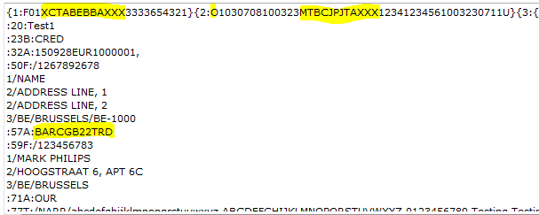
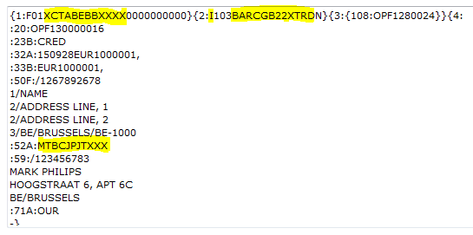
Not On-Us Payment
After Processing of Payment

Slide 13
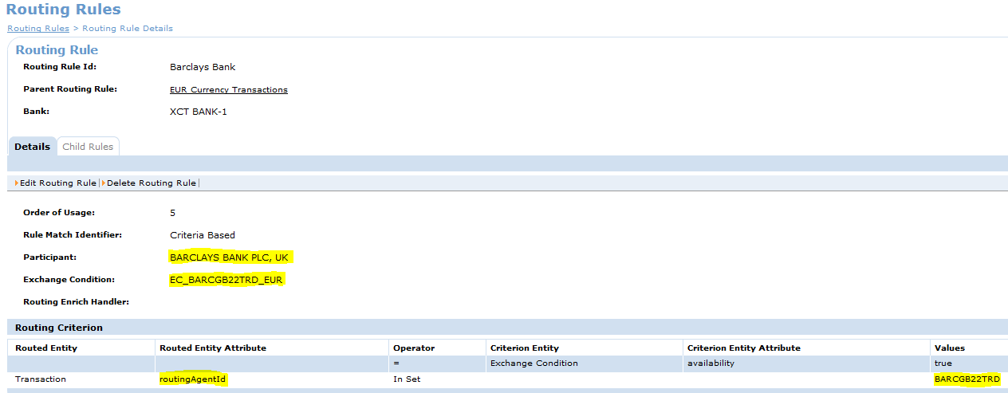
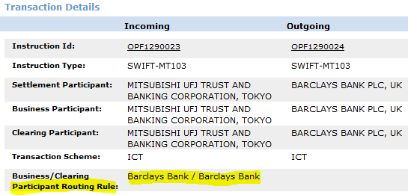
Routing Rule

Slide 14
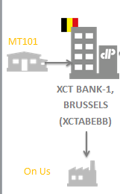
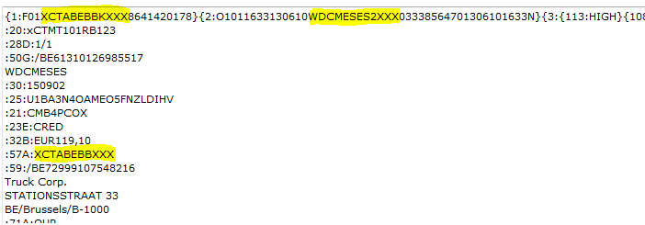
OPF Testers View – A Case Study (On Us Payment)

Slide 15
Use case - Walkthrough
A use case is a methodology used in system analysis to identify, clarify, and organize system requirements. The use case is made up of a set of possible sequences of interactions between systems and users in a particular environment and related to a particular goal
Major contents of Use case :
Brief Description
Actors
Primary Actors
Secondary Actors
Conditions
Pre-Condition
Post Conditions on success
Post Conditions on Failure
Trigger
Main Flow
Alternative Flow
Exception Flow
Extension Point
Attribute for storing data (Optional)
Business Rules
Validation Rules
System Messages
Screen Shots
Revision History
Reference Documentation

Slide 16
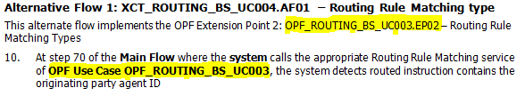
Use Case Integration
Product/Project use cases are integrated with OPF/XCT use cases when functionality/services are called from the product layer. Example below :-

Slide 17
Agenda
Parsers
Question and Answers
Hands-On

Slide 18
Parsers– Hands on
Hands On
Follow the hands on for the MT103 payment that would be routed to an External Participant.
Perform Hands on - Payment Routing via RTGS.
Make sure to take screenshots of all the evidences.

Slide 19
What you should Know after this?
What is Routing?
Routing Process high level Overview.
Outcome of routing service flow.

Slide 20
Routing training -Checklist
Walkthrough on SWIFT message (MT - Different Blocks)
Payment life cycle (From Payment processing prospective)
Participant
Participant Directory
Routing Rules
End to End of Payment Routing
Incoming Payment(Before Processing) & Outgoing payment(After processing)
Routing Rule – Practice (1) – with T57,
Routing Rule – Practice (2) – with T56 and T57
Routing Rule – Practice (3) – On Us Payment
Routing Rule – Practice (4) – RTGS payment
Use case description and walkthrough
Use case Integration

Slide 21

Question *A matter requiring resolution or discussion.
Open Your Mind
Widen Your Thoughts

Slide 22
Revision History
Date | Rev | Who | Description
 | 0.1 |  | Initial verison
19/10/2015 | 0.2 | Rakesh Bhardwaj | Added Participant, Participant ion Directory, Routing Rules slides Added Routing - Algorithm Added BVA screens for Not On-Us/On-Us payment Added Use case walkthrough slides Added Use case Integration slides Realigned slides,

Slide 23
EMEA – Headquarters
Brussels, Belgium
info@clear2pay.com
APAC
Sydney, Australia
info.apac@clear2pay.com
Americas
Atlanta, USA
info.americas@clear2pay.com
www.clear2pay.com

